Slide 1
TCSS 305, Autumn 2005
Unit 9:
Events
Horstmann Ch. 8
These lecture notes are copyright (C) Marty Stepp and Stuart Reges, 2005. They may not be rehosted, sold, or modified without expressed permission from the authors. All rights reserved.

Slide 2
GUI is not done yet...
What is missing?
  Why don't the buttons do anything when we click them?
  How can we fix this problem?
Next topic: events
  (making the GUI responsive to user interaction)
  allows our own GUIs to be interactive like JOptionPane

Slide 3
Action Events with
The ActionListener interface

Slide 4
Event-driven Programming
program's execution is indeterminate
on-screen components cause events to occur when they are clicked / interacted with
events can be handled, causing the program to respond, driving the execution thru events (an "event-driven" program)

Slide 5
Java Event Hierarchy
java.lang.Object
+--java.util.EventObject
+--java.awt.AWTEvent
+--java.awt.event.ActionEvent
+--java.awt.event.TextEvent
+--java.awt.event.ComponentEvent
+--java.awt.event.FocusEvent
+--java.awt.event.WindowEvent
+--java.awt.event.InputEvent
+--java.awt.event.KeyEvent
+--java.awt.event.MouseEvent
import java.awt.event.*;

Slide 6
Action events (ActionEvent)
most common / simple event type in Swing
represent an action occurring on a GUI component
created by:
  button clicks
  check box checking / unchecking
  menu clicks
  pressing Enter in a text field
  etc.

Slide 7

Listening for events
attach listener to component
listener’s appropriate method will be called when event occurs (e.g. when the button is clicked)
for Action events, use ActionListener

Slide 8
Writing an ActionListener
// part of Java; you don’t write this
public interface ActionListener {
public void actionPerformed(ActionEvent event);
}
// Prints a message when the button is clicked.
public class MyActionListener
implements ActionListener {
public void actionPerformed(ActionEvent event){
System.out.println("Event occurred!");
}
}

Slide 9
Attaching an ActionListener
JButton button = new JButton("button 1");
ActionListener listener = new MyActionListener();
button.addActionListener(listener);
now button will print "Event occurred!" when clicked
addActionListener method exists in many Swing components

Slide 10
ActionEvent objects
public Object getSource()
Returns object that caused this event to occur.
public String getActionCommand()
Returns a string that represents this event.
(for example, text on button that was clicked)
Question: Where to put the listener class?

Slide 11
Inner class listener
public class Outer {
private class Inner implements ActionListener {
public void actionPerformed(
ActionEvent event) {
...
}
}
public Outer() {
JButton myButton = new JButton();
myButton.addActionListener(new Inner());
}
}

Slide 12
Anonymous inner listener
public class Outer {
public Outer() {
JButton myButton = new JButton();
myButton.addActionListener(
new ActionListener() {
public void actionPerformed(ActionEvent e) {
...
}
}
);
}
}

Slide 13
ActionListener in JFrame
public class Outer extends JFrame
implements ActionListener {
public Outer() {
JButton myButton = new JButton();
myButton.addActionListener(this);
}
public void actionPerformed(ActionEvent event) {
...
}
}

Slide 14
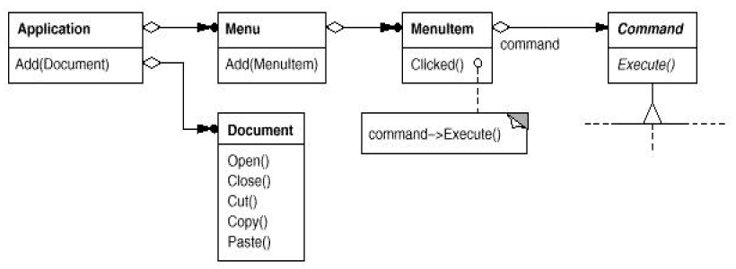
Action Events with
The Action class
objects that represent actions

Slide 15
Open-closed principle
Open-Closed Principle: Software entities like classes, modules and functions should be open for extension but closed for modifications.
The Open-Closed Principle encourages software developers to design and write code in a fashion that adding new functionality would involve minimal changes to existing code.
  most changes will be handled as new methods and new classes
  designs following this principle would result in resilient code which does not break on addition of new functionality

Slide 16
Bad event-handling code
public class TicTacToeGui implements ActionListener {
...
public void actionPerformed(ActionEvent event) {
if (event.getSource() == view1Item){
// switch to view #1 ...
else { // event source must be view2Item
// switch to view #2 ...
}
}
}
in this code, the "master" TTT GUI object is in charge of all action events in the UI
  is this bad?
  what could happen if we add another action event source?

Slide 17
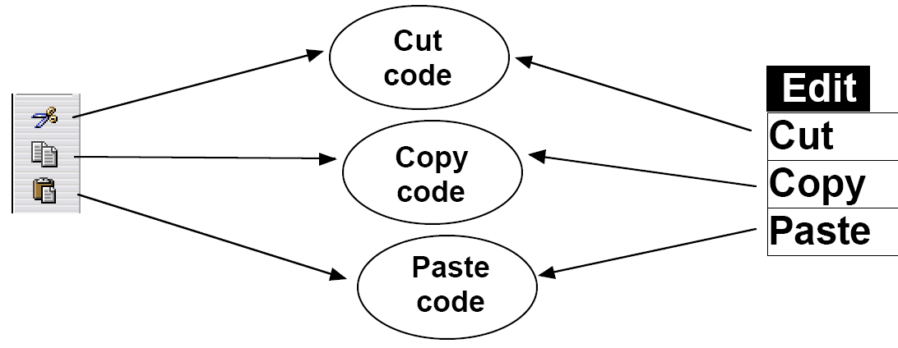
Common UI commands
it is common in a GUI to have several ways to activate the same behavior
  example: toolbar "Cut" button and "Edit / Cut" menu
  this is good ; it makes the program flexible for the user
  we'd like to make sure the code implementing these common commands is not duplicated

Slide 18
Solution: Actions
Java's Action interface represents a UI command
  a UI command has a text name, an icon, an action to run
  can define multiple UI widgets that share a common underlying command by attaching the same Action to them
  These Swing components support Action
    JButton(Action a) JToggleButton(Action a)
    JCheckBox(Action a) JMenuItem(Action a)
    JRadioButton(Action a)
AbstractAction class implements Action and maintains an internal map of keys to values
  each key represents a name of a property of the action (e.g. "Name")
  each value represents the value for that property (e.g. "Save Game")
  can be used to ensure that all UI components that share a common UI action will have the same text, icon, hotkey

Slide 19
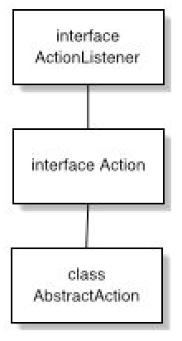
ActionListener, Action code
reminder: interface ActionListener
  public void actionPerformed(ActionEvent e)
interface Action extends ActionListener
  adds property enabled
    isEnabled() / setEnabled(boolean)
abstract class AbstractAction implements Action
  you must still write actionPerformed

Slide 20
AbstractAction members
public class AbstractAction implements Action
  public AbstractAction(String name)
  public AbstractAction(String name, Icon icon)
  public Object getValue(String key)
  public boolean isEnabled()
  public void putValue(String key, Object value)
  public void setEnabled(boolean enabled)
  ...
AbstractAction object maintains an internal map of keys to values
  each key represents a name of a property of the action (e.g. "Name")
  each value represents the value for that property (e.g. "Save Game")

Slide 21
Using Action, example
define a class that extends AbstractAction:
public class CutAction extends AbstractAction {
public CutAction() {
super("Cut", new ImageIcon("cut.gif"));
}
public void actionPerformed(ActionEvent e) {
// do the action here ...
}
}
create an object of this class, attach it to UI objects:
CutAction cut = new CutAction();
JButton cutButton = new JButton(cut);
JMenuItem cutMItem = new JMenuItem(cut);
now the same action will occur in both places; also, changes to the action will be seen on both widgets:
cut.setEnabled(false);

Slide 22
Action and Swing components
Other uses: properties of the action can be set
  cut.putValue(Action.SHORT_DESCRIPTION,
  "Cuts the selected text");
    will use this label for the tooltip text
  cut.putValue(Action.NAME, "Cut");
    will use the text label "Cut" for the name of the command
  cut.putValue(Action.MNEMONIC_KEY,
  new Integer('T'));
    will underline 't' in "Cut" as a mnemonic hotkey for the command
  cut.putValue(Action. ACCELERATOR_KEY,
  KeyStroke.getKeyStroke('X', KeyEvent.CTRL_MASK));
    will use Ctrl-X as an accelerator hotkey for the command

Slide 23
Command pattern
Command: an object that represents an action
  sometimes called a "functor" to represent an object whose sole goal is to encapsulate one function
  Java API examples:
    ActionListener, Comparator, Runnable / Thread

Slide 24
Command applications
command objects serve as a "model" of commands:
  separates the user interface from them
  each model can support multiple views
  each action can support multiple widgets
use the Command pattern when you want to:
  implement a callback function capability
  have several UI widgets that cause the same action to occur
  specify, queue, and execute requests at different times
  support undo and change log operations

Slide 25
References
Java API pages
  http://java.sun.com/j2se/1.4.2/docs/api/javax/swing/Action.html
  http://java.sun.com/j2se/1.4.2/docs/api/javax/swing/AbstractAction.html
Cunningham & Cunningham OO Consultancy, Inc.
  http://c2.com/cgi/wiki?AbstractFactoryPattern
  http://c2.com/cgi/wiki?FactoryMethodPattern
  http://c2.com/cgi/wiki?CommandPattern
Design Patterns Java Companion
  http://www.patterndepot.com/put/8/JavaPatterns.htm
Design Pattern Synopses
  http://www.mindspring.com/~mgrand/pattern_synopses.htm

Slide 26
Mouse and Keyboard Events

Slide 27

Mouse events
Uses of mouse events:
  listen to clicks and movement of mouse within a GUI component (usually a panel)
  respond to mouse activity with appropriate actions
  create interactive programs that are driven by mouse activity

Slide 28
Listening to clicks: MouseListener
package java.awt.event;
public interface MouseListener {
public void mouseClicked(MouseEvent event);
public void mouseEntered(MouseEvent event);
public void mouseExited(MouseEvent event);
public void mousePressed(MouseEvent event);
public void mouseReleased(MouseEvent event);
}

Slide 29
MouseListener example
public class MyMouseListener implements MouseListener {
public void mouseClicked(MouseEvent event) {}
public void mouseEntered(MouseEvent event) {}
public void mouseExited(MouseEvent event) {}
public void mousePressed(MouseEvent event) {
System.out.println("User pressed mouse button!");
}
public void mouseReleased(MouseEvent event) {}
}

Slide 30
MouseListener usage
// assumes some custom panel class named MyPanel
MyPanel panel = new MyPanel();
panel.addMouseListener(new MyMouseListener());
Problem: Tedious to implement entire interface when only partial behavior is wanted/needed

Slide 31
MouseAdapter
an abstract class with empty implementations of all MouseListener methods
usage: extend MouseAdapter and override the methods you want to do something
removes need for you to type in empty methods for all the ones you don’t want
an example of the Adapter design pattern

Slide 32
MouseAdapter usage
public class MyMouseAdapter extends MouseAdapter {
public void mousePressed(MouseEvent event) {
System.out.println("User pressed mouse button!");
}
}
...
// using the MyMouseAdapter
MyPanel panel = new MyPanel();
panel.addMouseListener(new MyMouseAdapter());

Slide 33

MouseEvent objects
InputEvent
  public static int BUTTON1_MASK,
  BUTTON2_MASK, BUTTON3_MASK,
  CTRL_MASK, ALT_MASK, SHIFT_MASK
MouseEvent
  public int getClickCount()
  public Point getPoint()
  public int getX(), getY()
  public Object getSource()
  public int getModifiers()
  (use the above button masks with this)
SwingUtilities
  isLeftMouseButton(MouseEvent event)
  isRightMouseButton(MouseEvent event)

Slide 34
MouseEvent: usage
public class MyMouseAdapter extends MouseAdapter {
public void mousePressed(MouseEvent event) {
Point p = event.getPoint();
Object source = event.getSource();
if (source == this.panel && p.getX() < 10) {
JOptionPane.showMessageDialog(null,
"You clicked the left side of myPanel!");
}
}
}

Slide 35
Mouse movement: MouseMotionListener
package java.awt.event;
public interface MouseMotionListener {
public void mouseDragged(MouseEvent event);
public void mouseMoved(MouseEvent event);
}
abstract MouseMotionAdapter class provides empty implementations of both methods if you just want to override one

Slide 36
MouseMotionAdapter: example
public class MyMouseMotionAdapter extends MouseMotionAdapter {
public void mouseMoved(MouseEvent event) {
Point p = event.getPoint();
double x = event.getX();
double y = event.getY();
System.out.println("Mouse is at " + p);
System.out.println("x is " + x);
System.out.println("y is " + y);
}
}
// using the listener
myPanel.addMouseMotionListener(new MyMouseMotionAdapter());

Slide 37
MouseInputListener
package javax.swing.event;
public interface MouseInputListener
extends MouseListener, MouseMotionListener {}
more importantly: MouseInputAdapter class includes empty implementations for ALL methods from both mouse input interfaces, allowing same listener to listen to mouse clicks and movement

Slide 38
MouseInputAdapter: Example
public class MyMouseInputAdapter extends MouseInputAdapter {
public void mousePressed(MouseEvent event) {
System.out.println("Mouse was pressed");
}
public void mouseMoved(MouseEvent event) {
Point p = event.getPoint();
System.out.println("Mouse is at " + p);
}
}
...
// using the listener
MyMouseInputAdapter adapter = new MyMouseInputAdapter();
myPanel.addMouseListener(adapter);
myPanel.addMouseMotionListener(adapter);

Slide 39

Keyboard Events
Usage of keyboard events:
  listen to keyboard activity within a GUI component
  (usually a panel)
  respond to keyboard activity with appropriate actions
  control onscreen drawn characters and simulate text input

Slide 40
Key Presses: KeyListener
package java.awt.event;
public interface KeyListener {
public void keyPressed(KeyEvent event);
public void keyReleased(KeyEvent event);
public void keyTyped(KeyEvent event);
}
abstract class KeyAdapter implements all KeyListener methods

Slide 41
KeyEvent objects
InputEvent
  public static int CTRL_MASK,
  ALT_MASK, SHIFT_MASK
KeyEvent
  public static int VK_A .. VK_Z,
  VK_0 .. VK_9,
  VK_F1 .. VK_F10,
  VK_UP, VK_LEFT, ..,
  VK_TAB, VK_SPACE, VK_ENTER, ...
  (one for every key)
  public char getKeyChar()
  public int getKeyCode()
  public Object getSource()
  public int getModifiers()
  (use masks with this)

Slide 42
KeyAdapter example
class PacManKeyListener extends KeyAdapter {
public void keyPressed(KeyEvent event) {
char keyChar = event.getKeyChar();
int keyCode = event.getKeyCode();
if (keyCode == KeyEvent.VK_RIGHT) {
pacman.setX(pacman.getX() + 1);
pacpanel.repaint();
} else if (keyChar == 'Q') {
System.exit(0);
}
}
}
// assumes some custom panel class named PacPanel
PacPanel panel = new PacPanel();
panel.addKeyListener(new PacKeyListener());

Slide 43
Other kinds of events
WindowListener/Adapter/Event:
Responds to events in a top-level window (JFrame). Useful to catch windowClosing event and respond, e.g. prompt to save current file
FocusListener/Event:
Responds to when the keyboard focus changes to a different component.
Useful to validate input format on a text field
ListSelectionListener, HyperlinkListener, ItemListener:
Event listeners for specific Swing components (JList, JEditorPane, JComboBox respectively)

Slide 44
For Reference
Core Java Ch. 8
The Java Tutorial: How to Write a Mouse Listener.
http://java.sun.com/docs/books/tutorial/
uiswing/events/mouselistener.html
The Java Tutorial: How to Write a Mouse Motion Listener.
http://java.sun.com/docs/books/tutorial/
uiswing/events/mousemotionlistener.html
The Java Tutorial: How to Write a Key Listener.
http://java.sun.com/docs/books/tutorial/
uiswing/events/keylistener.html

